Slide 1




GENDER CLASSIFICATION FROM AUDIO SIGNALS USING GNNS
Advanced Machine Learning (06SM521-533)
Abu Bakr Rahman Shaik - 23-756-737 abubakrrahman.shaik@uzh.ch
Azizbek Asadov - 23-747-041 - azizbek.asadov@uzh.ch
Jaaylin Anthony Martin - 24-741-530 - jaaylinanthony.martin@uzh.ch

Slide 2


Agenda
01 | Problem Setting
04 | Related Work
05 | Methodology
06 | Analysis & Evaluation
07 | Conclusion

Slide 3
Problem Setting

Slide 4


Problem Setting
Gender classification real-world applications:
Security systems (e.g., voice authentication)
Healthcare (e.g., telemonitoring)
Human-computer interaction (personalized experiences)
Recent literature (Sensors 2024) showed GNNs excel in audio-based classification

Slide 5
Problem Setting
Gender classification real-world applications:
Security systems (e.g., voice authentication)
Healthcare (e.g., telemonitoring)
Human-computer interaction (personalized experiences)
Recent literature (Sensors 2024) showed GNNs excel in audio-based classification
Main Objective: Evaluate and compare 3 GNN and implement 3 PTMs architectures on this task

Slide 6
Related Work

Slide 7
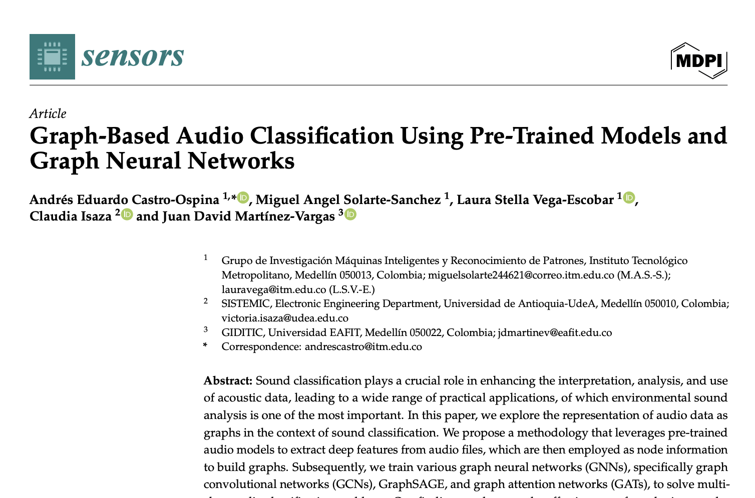
Related Work
Graph-Based Audio Classification Using Pre-Trained Models and Graph Neural Networks (Castro-Ospina et al. 2024)

Slide 8
Methodology

Slide 9
Methodology
We split our pipeline into 4 major stages:
1. Audio Feature Extraction using pre-trained models
2. Graph Construction based on extracted features
3. GNN Model Training (GCN, GAT)
4. Evaluation using standard classification metrics

Slide 10
Audio Feature Extraction
• PTM selected: PANNs (Pretrained Audio Neural Networks)
• Alternatives: VGGish, YAMNet
• Features extracted:
• Mel spectrogram
• Log-mel embeddings
• Tools: librosa, panns-inference, tensorflow_hub

Slide 11
Graph Construction
Constructed graphs using k-Nearest Neighbors (kNN)
Nodes: audio samples
Edges: similarity (Euclidean distance between feature vectors)
Libraries: torch_geometric, sklearn
Challenges:
Dataset labels were unknown initially → required re-labeling
Feature normalization was needed

Slide 12
GNN Architectures Implemented
GCN (Graph Convolutional Network)
Spectral-based aggregation of neighbor features
GAT (Graph Attention Network)
Attention-weighted neighbor feature aggregation
Both models used:
CrossEntropyLoss
Adam optimizer
Dropout for regularization

Slide 13
Datasets Used
Voice Gender Dataset (Kaggle)
3,168 samples
21 engineered audio features (e.g., mean frequency, pitch, jitter)
Gender Recognition by Voice
16,000 raw audio samples
Used PANNs to extract features
Had to filter out unknown labels

Slide 14
Analysis & Evaluation

Slide 15
Analysis & Evaluation
Primary Metric: Accuracy
Additional Metrics:
Precision
Recall
F1-Score
Efficiency:
Training time per epoch
Convergence rate

Slide 16
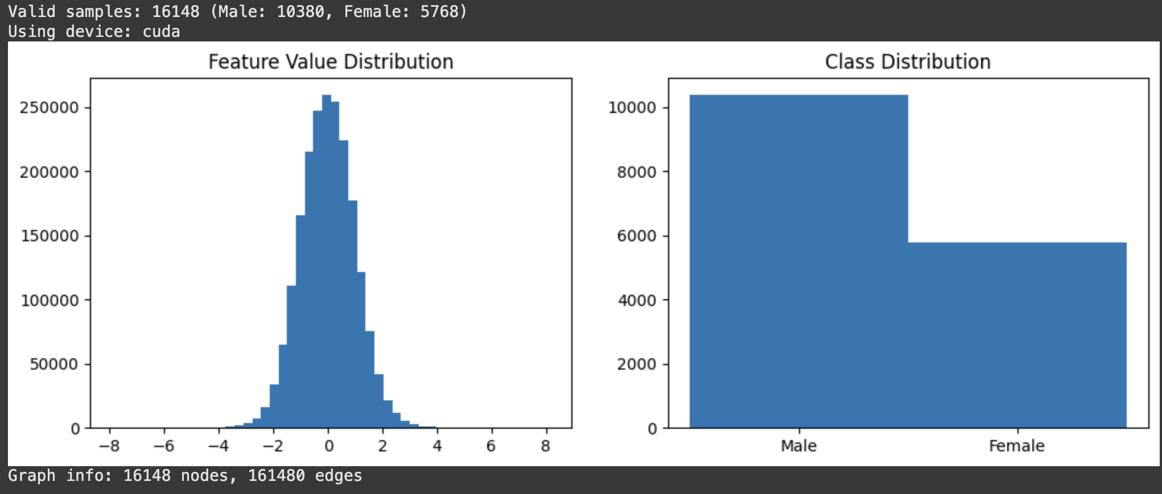
Analysis & Evaluation

Slide 17
Analysis & Evaluation
Model | Accuracy | Precision | Recall | F1
GCN | 82.4% | 81.2% | 83.0% | 82.0%
GAT | 84.6% | 83.9% | 84.8% | 84.3%

Slide 18
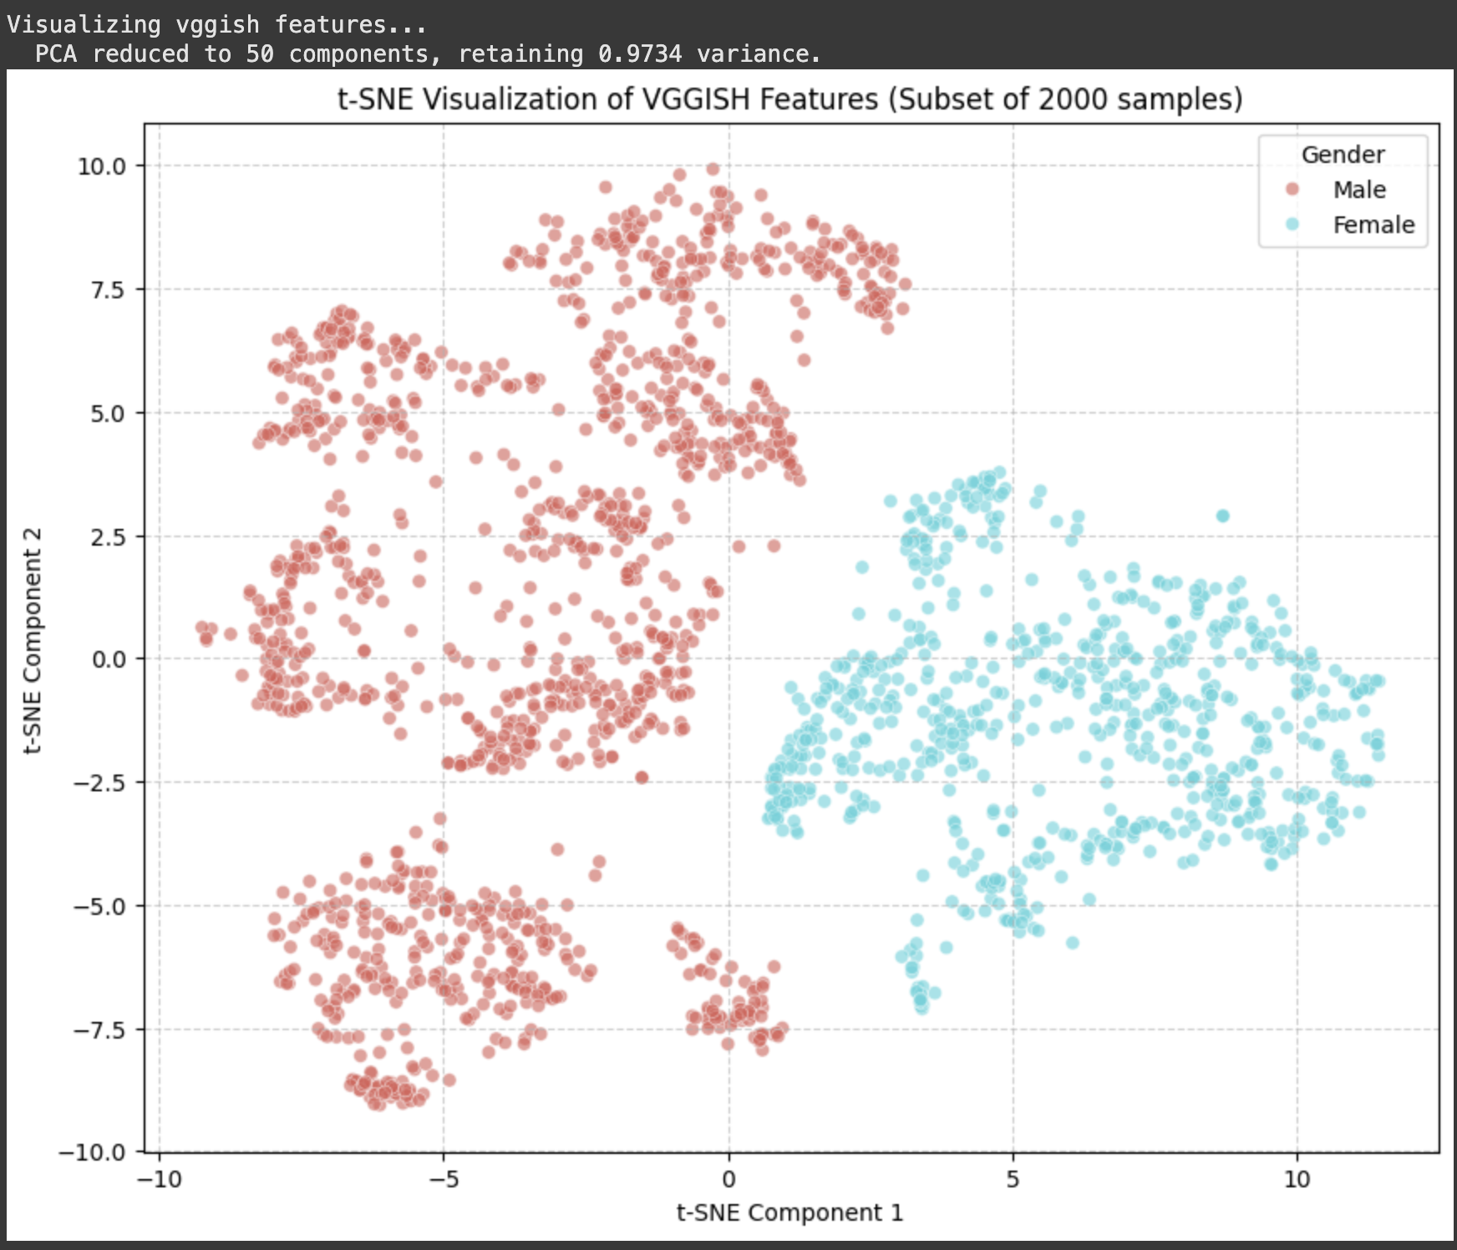
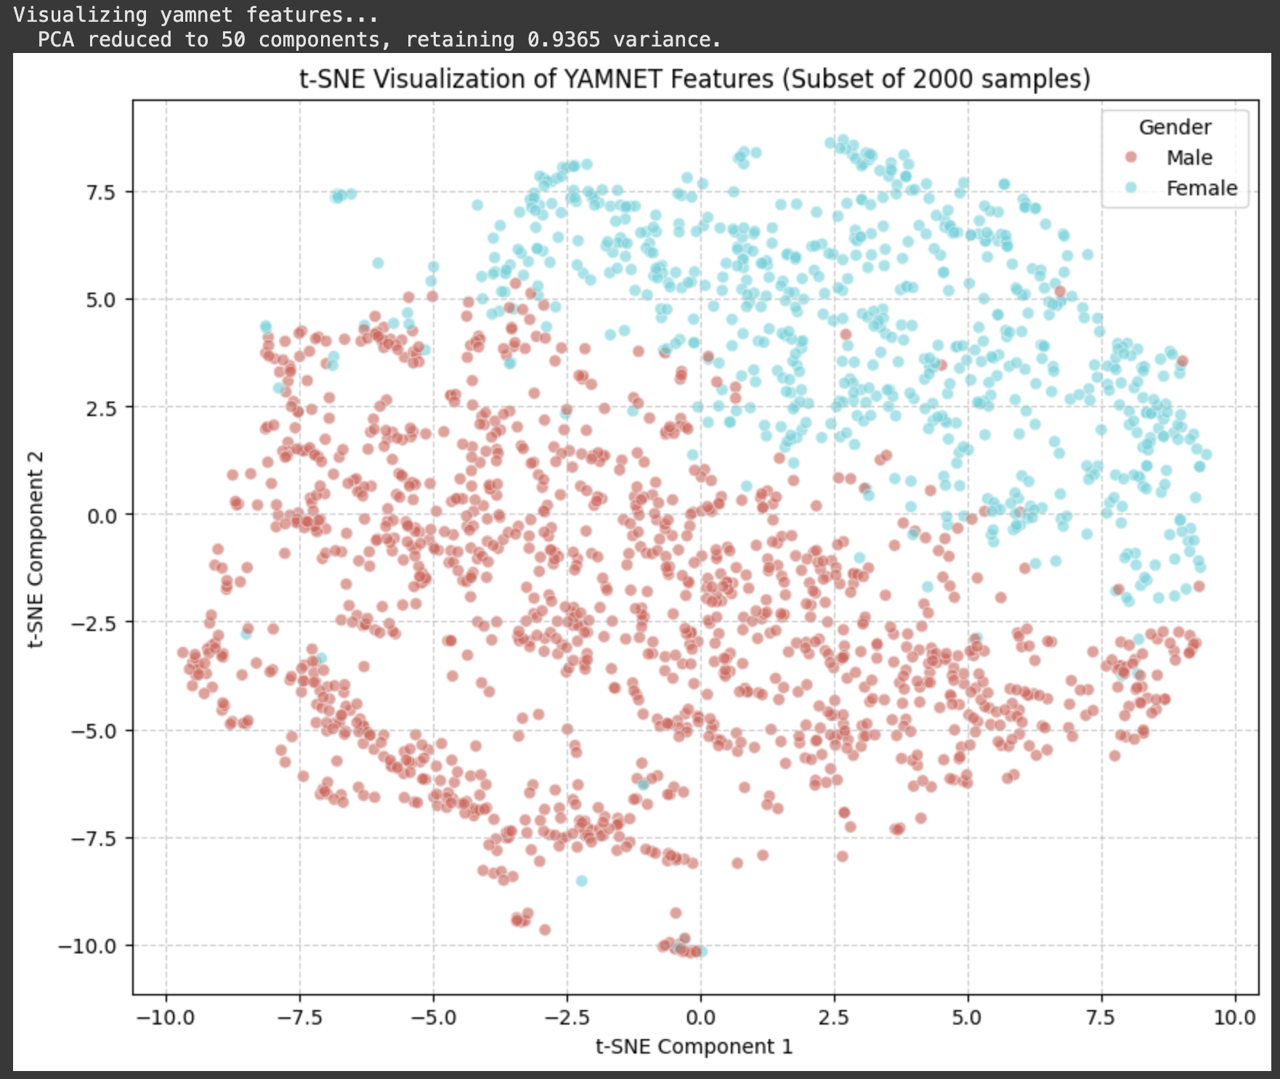
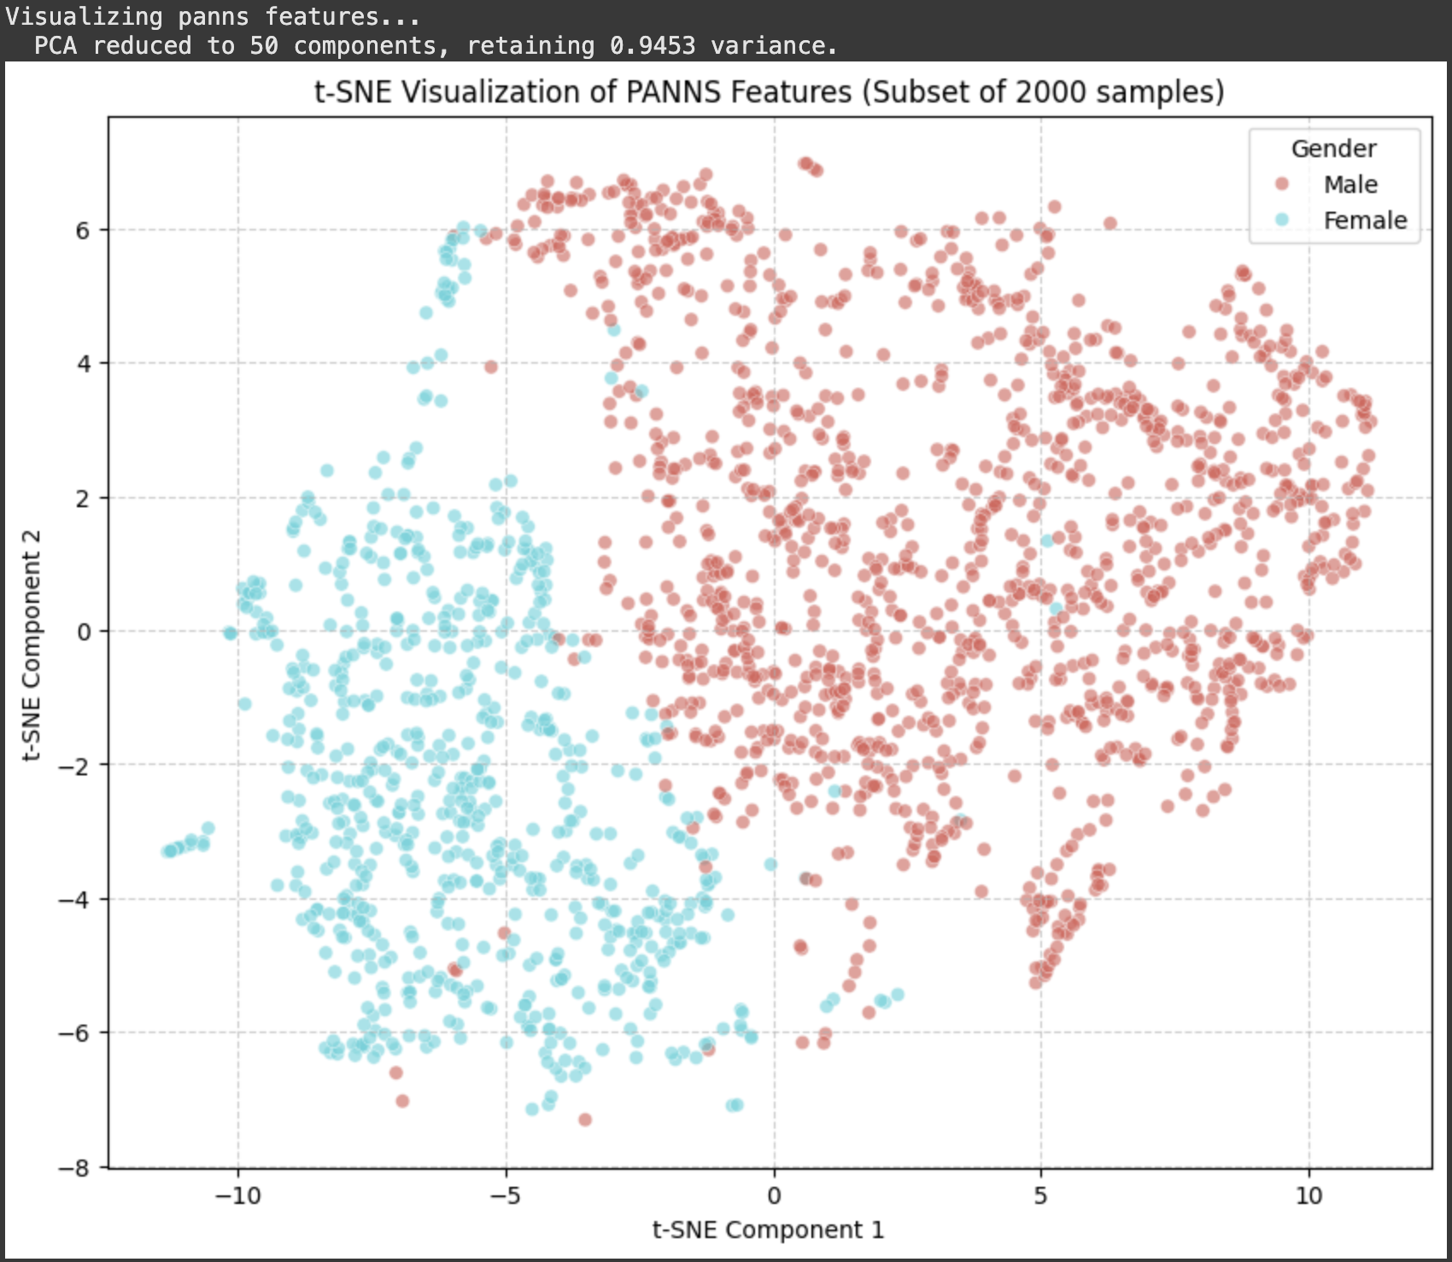
Analysis & Evaluation

Slide 19
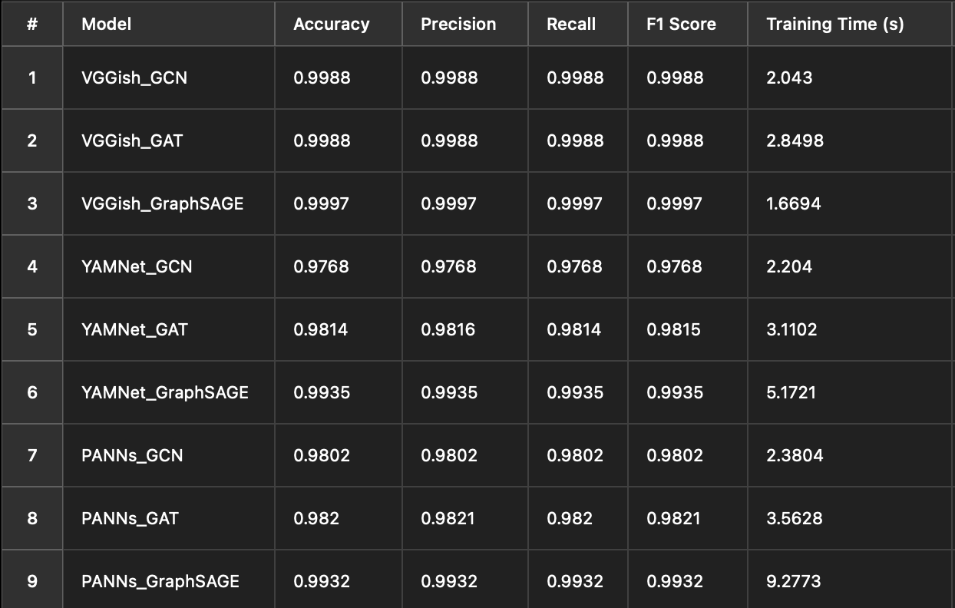
Analysis & Evaluation
GNN Audio Classification Performance

Slide 20
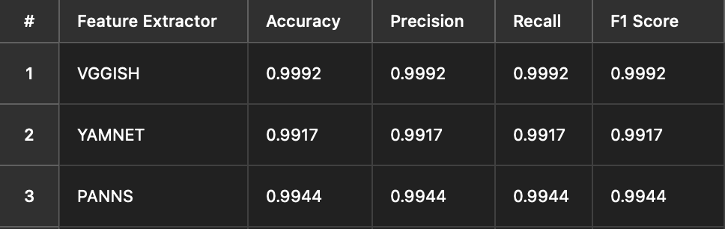
Analysis & Evaluation
Base Model Performance

Slide 21
Challenges
Dataset imbalance: more male than female samples
Graph construction without original paper code
PTM outputs were large → required dimensionality reduction
Hardware limitations for training GNNs

Slide 22
Insights & Observations
Audio features do encode gender-specific traits
Graph-based methods can capture cross-sample patterns
Attention mechanism in GAT helps focus on relevant neighbors
Need better labeling and more balanced datasets

Slide 23
Comparison to 2D Classifiers
Model Type | Pros | Cons
CNN/RNN | Fast, good for local patterns | Ignores sample relationships
GNN | Models inter-sample similarity | Slower, harder to tune

Slide 24
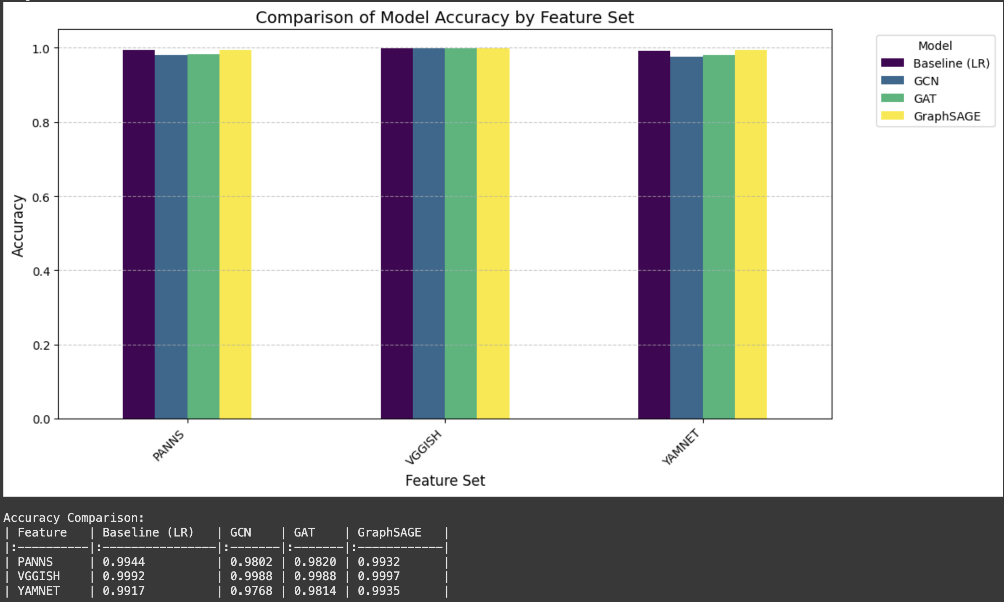
Comparison to 2D Classifiers

Slide 25
Conclusions

Slide 26
Future Work
Test multiple PTMs and compare feature embeddings
Extend to multi-class classification (e.g., age, accent, emotion)
Introduce self-supervised pretraining on audio graphs
Evaluate robustness on noisy or real-world recordings

Slide 27
Conclusions
GNNs work well for audio-based gender classification
GraphSAGE + VGGish delivered the best performance
Pretrained models (PTMs) are key to feature quality
GAT captures complex patterns via attention
Baseline models are strong, but GNNs offer better scalability
And we implemented 3 PTMs and 3 GNNs!

Slide 28
Thank you

